Slide 1
Urban Photo Album
Notes:
This template can be used as a starter file for a photo album.

Slide 2
NEW PICTURE EFFECTS
Introducing

Slide 3
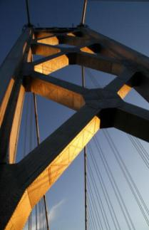
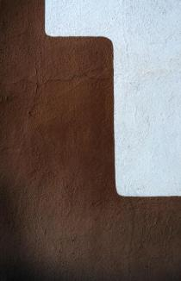
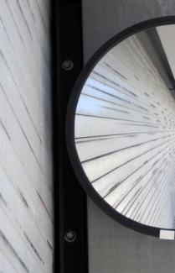
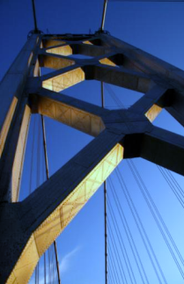
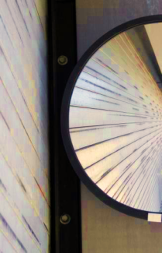
Before
After
Tone
Saturation
Color
You can use Picture Color to change the tone or saturation of your picture or to recolor it to a single color

Slide 4
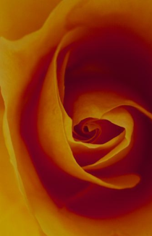
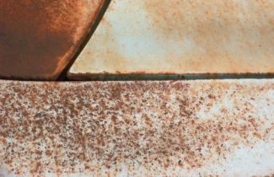
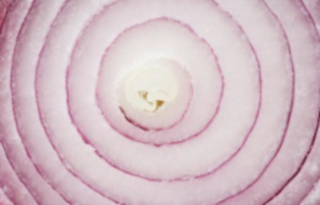
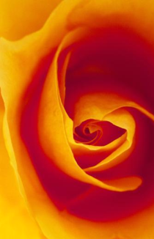
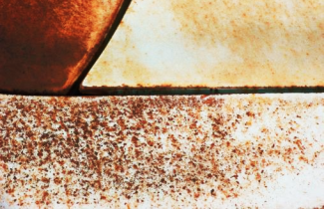
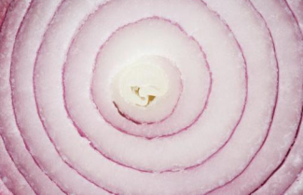
Before
After
Contrast
Brightness
Sharpness
Corrections allow you to change the contrast, brightness, and sharpness of your images.

Slide 5
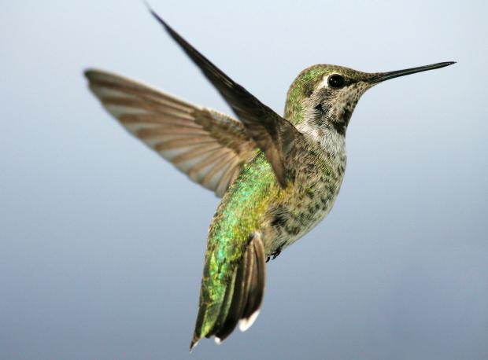
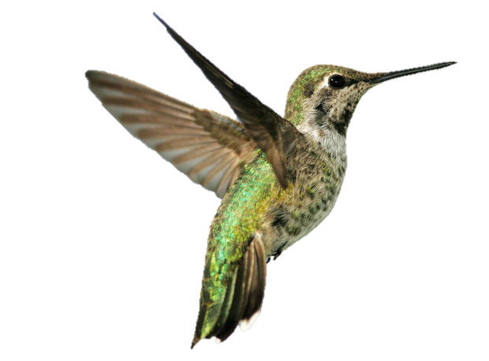
Focus on the Star of Your Photo
Background Removal allows you to quickly and easily remove backgrounds to isolate items in your image.

Slide 6
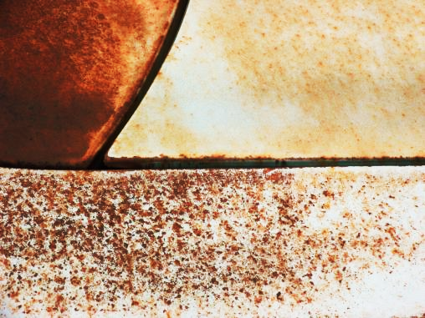
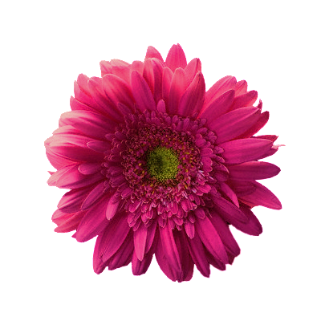
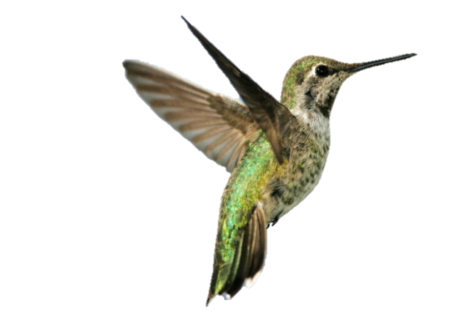
By layering multiple objects on a different background, you can create dynamic layouts

Slide 7
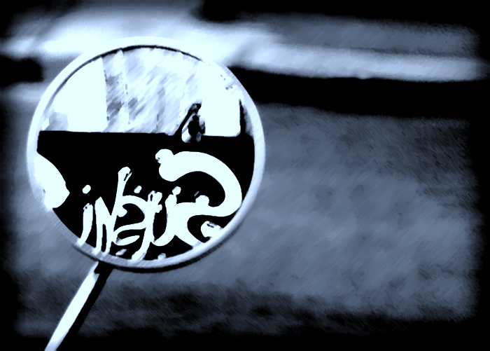
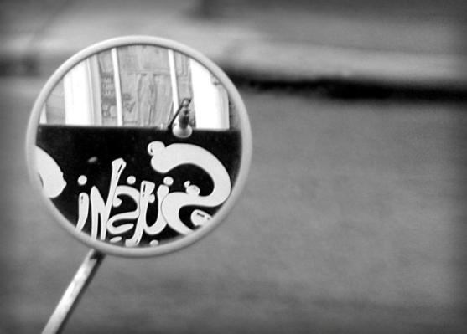
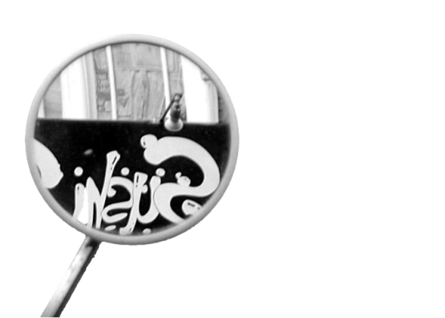
Dramatic effects can be achieved by layering an object over the same image with artistic effects

Slide 8
Snapshots
Mechanical Flower
New layouts bring
creativity to your presentation

Slide 9
Slide Film

Slide 10
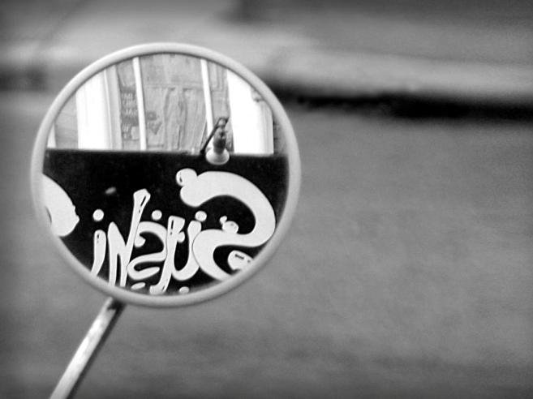
Photo Corners

Slide 11
PROFESSIONAL
DYNAMIC
ABSTRACT
SOPHISTICATED
CREATIVE
MODERN

Slide 12
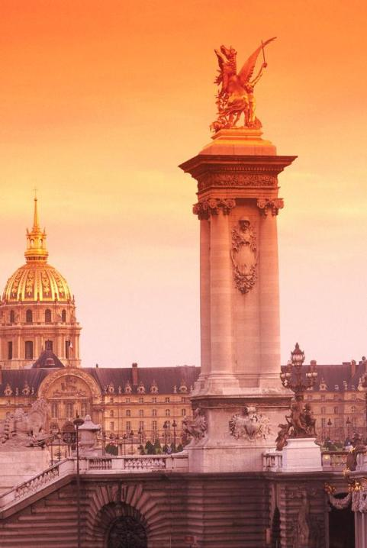
Split Picture
Use transitions to add something special to your photo album

Slide 13
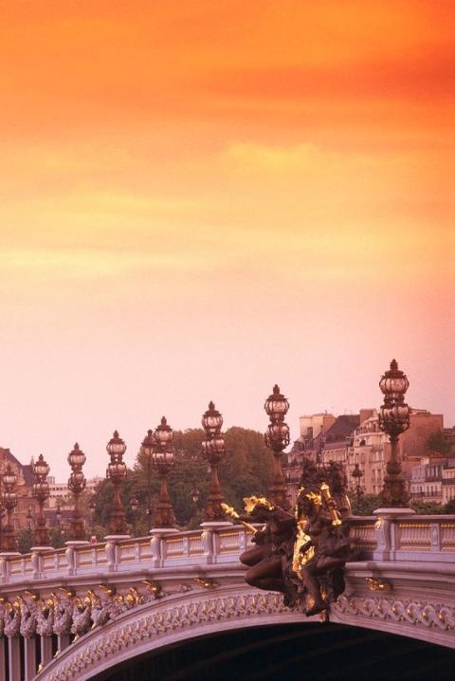
Split Picture

